Slide 1
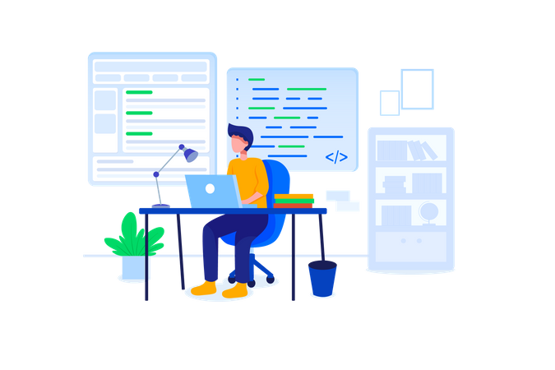
MEAN Stack Conclusion
Ending the Start, Starting the Journey

Slide 2

What did you learn during the workshop?

Slide 3

Workshop Recap
Familiarised MEAN stack (MongoDB, Express.js, Angular, Node.js)
HTML
CSS
Bootstrap
JavaScript
Angular
Typescript
Node
Express
MongoDB
Familiarised basics of containerization with Docker
Hands-on experience on a project

Slide 4
Unaddressed Topics
HTML:
Semantic Markup: Utilising semantic HTML elements for better accessibility and SEO.
Forms: Creating interactive forms with validation and input handling.
Media: Embedding multimedia content like images, videos, and audio.
Accessibility: Ensuring accessibility features for users with disabilities.
CSS:
Selectors: Understanding CSS selectors for targeting specific elements.
Layouts: Implementing responsive layouts using Flexbox or CSS Grid.
Transitions and Animations: Adding visual effects with CSS transitions and animations.
Preprocessors: Utilising CSS preprocessors like Sass or Less for enhanced styling capabilities.

Slide 5
Unaddressed Topics
Bootstrap:
Grid System: Utilising Bootstrap's grid system for creating responsive layouts.
Components: Leveraging Bootstrap components like navbars, modals, and carousels.
Utilities: Applying Bootstrap utility classes for quick styling adjustments.
Customization: Customizing Bootstrap themes and styles to match project requirements.
JavaScript:
DOM Manipulation: Interacting with the Document Object Model (DOM) to dynamically update web pages.
Event Handling: Managing user interactions and handling events like clicks, mouse movements, and keyboard inputs.
Asynchronous Programming: Understanding asynchronous JavaScript with promises, async/await, and callbacks.
Error Handling: Implementing error handling strategies to gracefully handle runtime errors.

Slide 6
Unaddressed Topics
TypeScript:
Static Typing: Utilizing TypeScript's static typing for improved code maintainability and bug detection.
Interfaces and Types: Defining interfaces and custom types for better code organization and documentation.
Tooling: Integrating TypeScript with build tools like webpack or parcel for transpiration and bundling.
Compatibility: Ensuring compatibility with existing JavaScript libraries and frameworks when using TypeScript.
OOP Concept
MongoDB:
Document-oriented storage
High scalability
Querying capabilities
Replication and sharding for horizontal scaling

Slide 7
Unaddressed Topics
Express.js:
Middleware support for request handling
Flexible routing mechanism
Support for various template engines
Built-in error handling middleware
Angular:
Two-way data binding for interactive UIs
Dependency injection for modular and testable code
Directives for reusable components
Services for shared functionality
Styling: Integration with CSS, Bootstrap for responsive designs.
TypeScript: Strongly typed language for building scalable applications.

Slide 8
Unaddressed Topics
Node.js:
Non-blocking I/O for high concurrency
Rich set of built-in modules
npm for package management
Event-driven architecture for asynchronous operations
Containerization with Docker:
Packaging applications and dependencies into container images
Portability across different environments

Slide 9
Then, what is the purpose of this workshop?

Slide 10

Then, what is the purpose of this workshop?
Familiarisation Objective: Introduce participants to the basic concepts of the MEAN stack and Docker.
Hands-On Experience: Provide opportunities for hands-on exploration and experimentation.
Understanding Ecosystem: Gain familiarity with the components and interactions within the MEAN stack.
Containerization Overview: Offer an overview of Docker and its role in modern web development.
Practical Exposure: Focus on practical exercises to give participants a feel for working with MEAN and Docker.
No In-Depth Learning: Clarify that the workshop is not designed for in-depth learning but rather for getting acquainted with the technologies.
Preparation for Further Learning: Lay the groundwork for participants to pursue further learning on their own after the workshop.

Slide 11

Leveling Up in MEAN Stack
Advancing with Cloud Native Techniques

Slide 12

Deployment of traditional MEAN Stack
Deployment: Typically deployed on physical servers, VMs, or traditional hosting
Monolithic Architecture: All components tightly coupled into a single deployable unit
Manual Scaling: Scaling and management done manually

Slide 13

What is Cloud-Native?
On-Premises:
Traditional computing model with infrastructure located within an organization's premises.
Requires full management of hardware, software, and networking internally.
Cloud:
Network of remote servers accessed over the internet.
Offers scalability, flexibility, and cost-effectiveness.
Cloud Computing:
Delivery of computing services over the internet.
Includes servers, storage, databases, and more.
Enables faster innovation and economies of scale.

Slide 14
What is Cloud-Native?
Applications designed for cloud environments.
Utilize microservices, containers, and dynamic orchestration.
Are highly scalable, resilient, and adaptable.
Companies using cloud native development
Capital One
Netflix
Pinterest
Huawei

Slide 15

The Significance of Cloud-Native Development
Cloud-Native Development:
Scalability: Enables effortless scaling based on demand.
Resilience: Incorporates built-in fault tolerance for reliability.
Agility: Supports rapid iteration and continuous delivery.
Cost Efficiency: Optimizes resource utilisation, leading to savings.
Microservices: Embraces a modular architecture for flexibility.
DevOps: Promotes the integration of development and operations.
Portability: Facilitates platform-agnostic deployment.
Containerization and Cloud Services:
Docker for containerization
Cloud platforms like AWS, Azure, and GCP

Slide 16
Tier 1 software engineering bootcamp
Develop a real-world Enterprise-level Web Application
Advanced MEAN stack development with a focus on cloud-native principles
Equip participants with the skills to build and deploy scalable MEAN stack applications in cloud environments
Learn the skills as and when needed for the product development
Learning ends when the product is successfully delivered

Slide 17

Benefits of tier 1 software engineering bootcamp
Batch of Students are converted into software team
Build a real world software product – end-to-end
Conceptualize, plan, analyze, design, develop, deploy into cloud
Self-organized agile team wearing multiple hats in rotation
Tech Lead, Developer
Business Analyst, UI/UX Designer
Project Manager, System Architect
Product Owner, Scrum Master
Led & mentored by a group of expert software professionals
Rinse, Repeat & Re-inforce (Practice multiple times)– till they become experts
Transforms each member into expert SDEs

Slide 18

Thanks

